Slide 1
What is Bracketing?
Bracketing: a technique in which several shots of the same subject are taken using different camera settings. Bracketing is useful and often recommended in situations that make it difficult to obtain a satisfactory image with a single shot.

Slide 2
Exposure Bracketing
The term bracketing usually refers to exposure bracketing: the photographer chooses to take one picture at a given exposure, one or more brighter, and one or more darker, in order to select the most satisfactory image.
Images produced using exposure bracketing are often combined in postprocessing to create a high dynamic range image that exposes different portions of the image by different amounts.

Slide 3
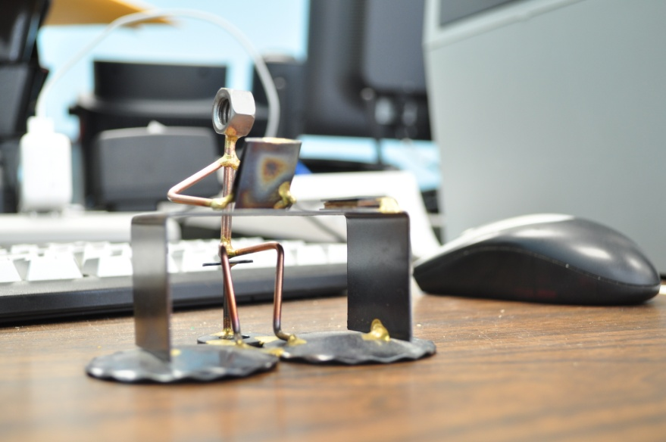
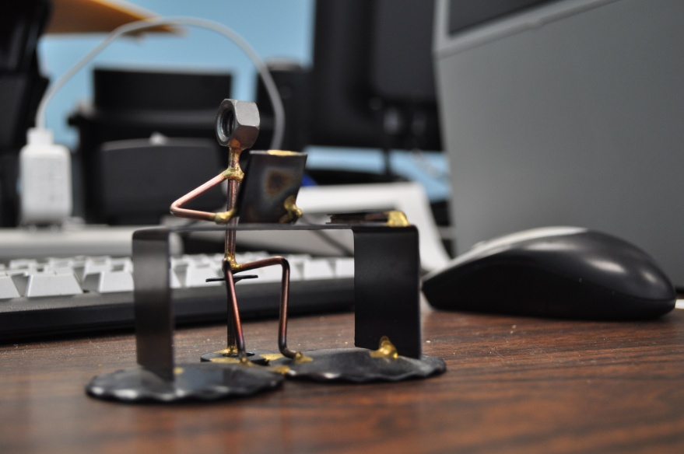
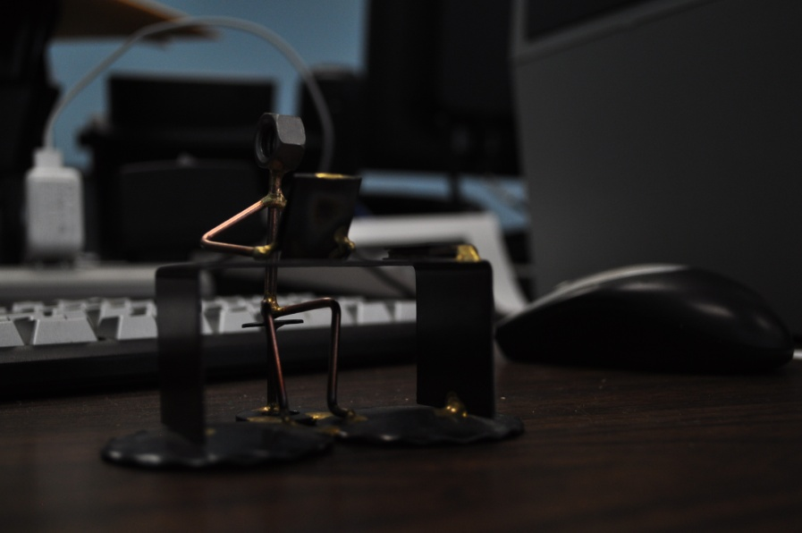
Exposure Bracketing
Overexposed
Proper Balance
Underexposed
Notes:
3

Slide 4
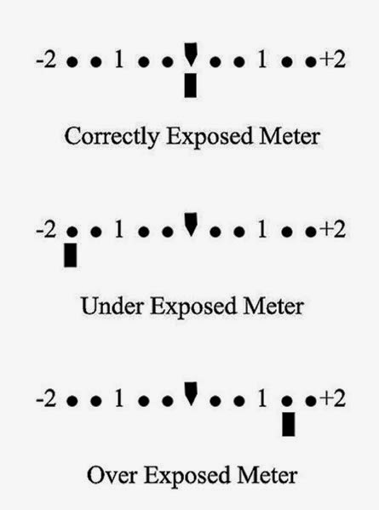
Exposure Bracketing
Technically, this is accomplished by changing either the shutter speed or the aperture.

Slide 5
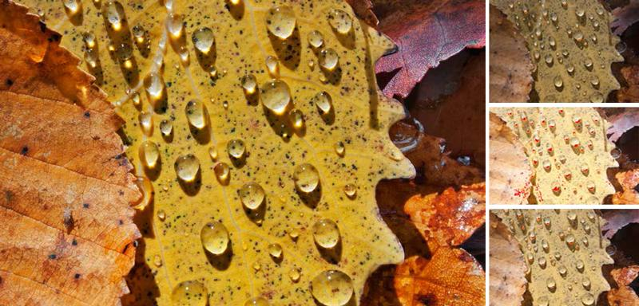
High Dynamic Range Images
To create High Dynamic Range (HDR) pictures. HDR pictures are created from several images, and include a lot of detail and vibrant colors to make the image stand out.

Slide 6
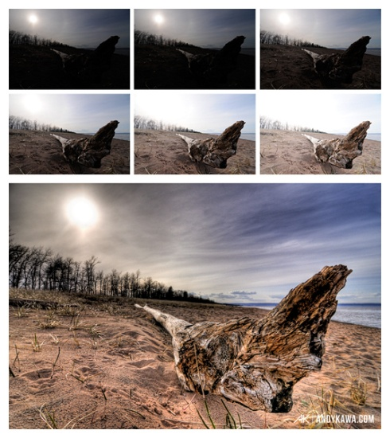
HDR Image

Slide 7
Other Types of Bracketing
Flash Bracketing: The amount of light provided by the flash is varied in a bracketed series in order to find the most pleasing combination of ambient light and fill flash.
DOF (Depth-of-field) bracketing comprises taking a series of pictures in stepped apertures (f-stops), while maintaining the exposure.

Slide 8
Other Types of Bracketing:
Focus Bracketing: situations with limited depth of field, such as macro photography, where one may want to make a series of exposures with different positions of the focal plane and then choose the one in which the largest portion of the subject is in focus. or combine the in-focus portions of multiple exposures digitally (focus stacking).
White Balance Bracketing, which is specific to digital photography, provides a way of dealing with mixed lighting by shooting several images with different white point settings.

Slide 9
Flash Bracketing
+1.0
0.0
-3.0

Slide 10
Flash Bracketing
Technically, this is accomplished by changing the flash compensation.
Flash compensation icon
-3.0 - + 1.0

Slide 11
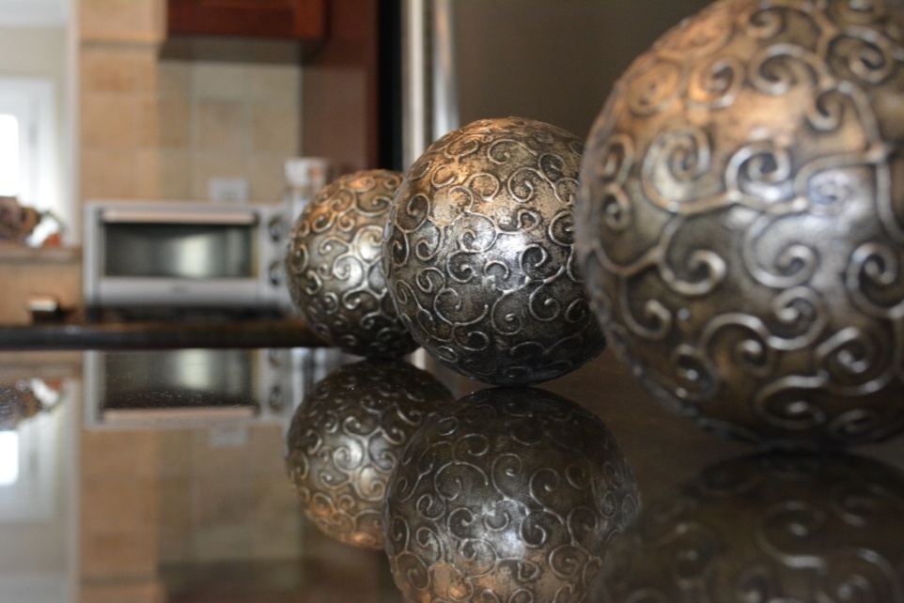
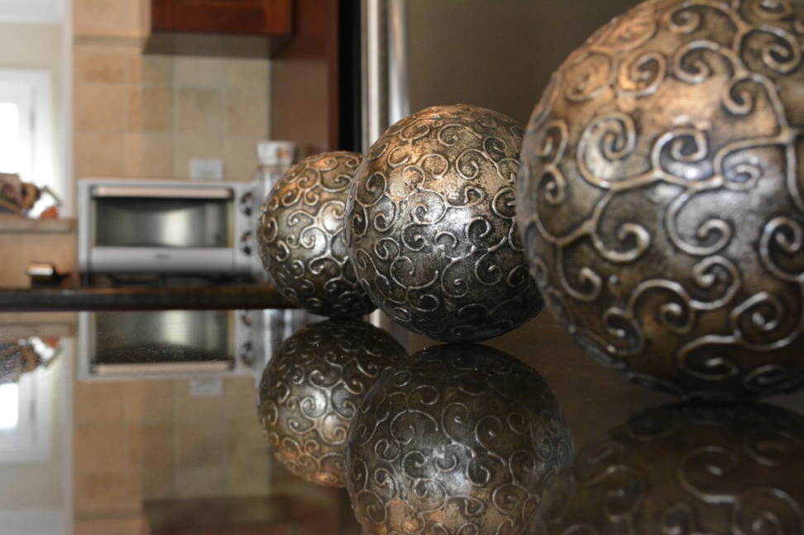
DOF Bracketing
f-5, ISO 2000
f-7.1, ISO 20000
f-10, ISO 2500

Slide 12
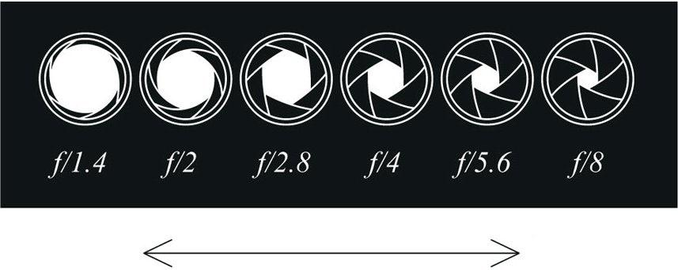
DOF Bracketing
Technically, this is accomplished by changing the aperture size, f-stop.
Shallow
Great

Slide 13
Focus Bracketing
Close features focused
Far features focused
Focus stacking
Notes:
13

Slide 14
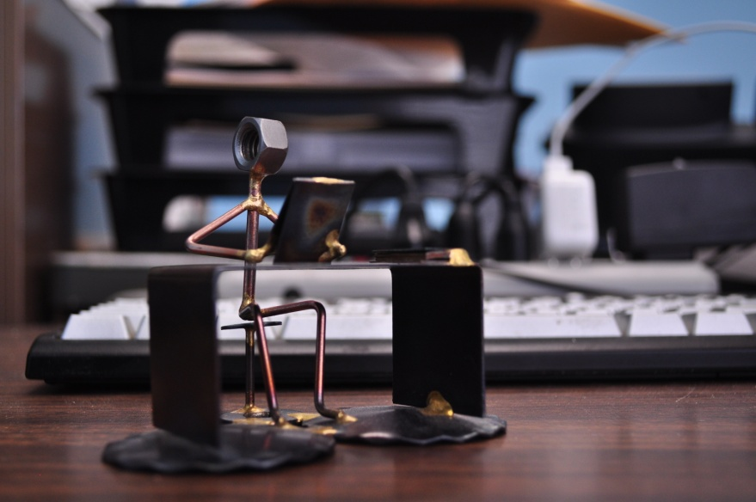
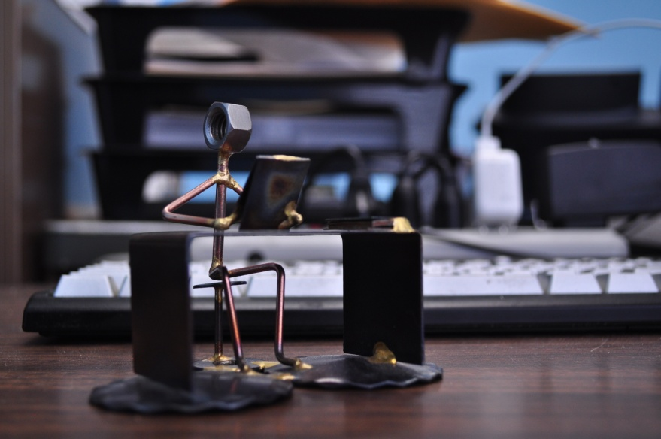
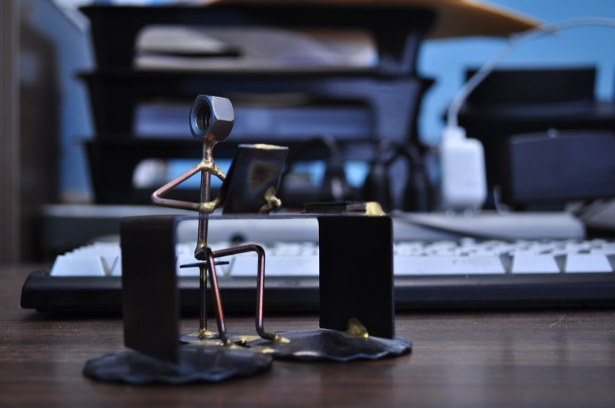
“WB Bracketing”
A1 = Increased Amber WB
Normal = User WB Setting
A1 WB
Normal WB
B1 = Increased Blue WB
B1 WB

